Slide 1


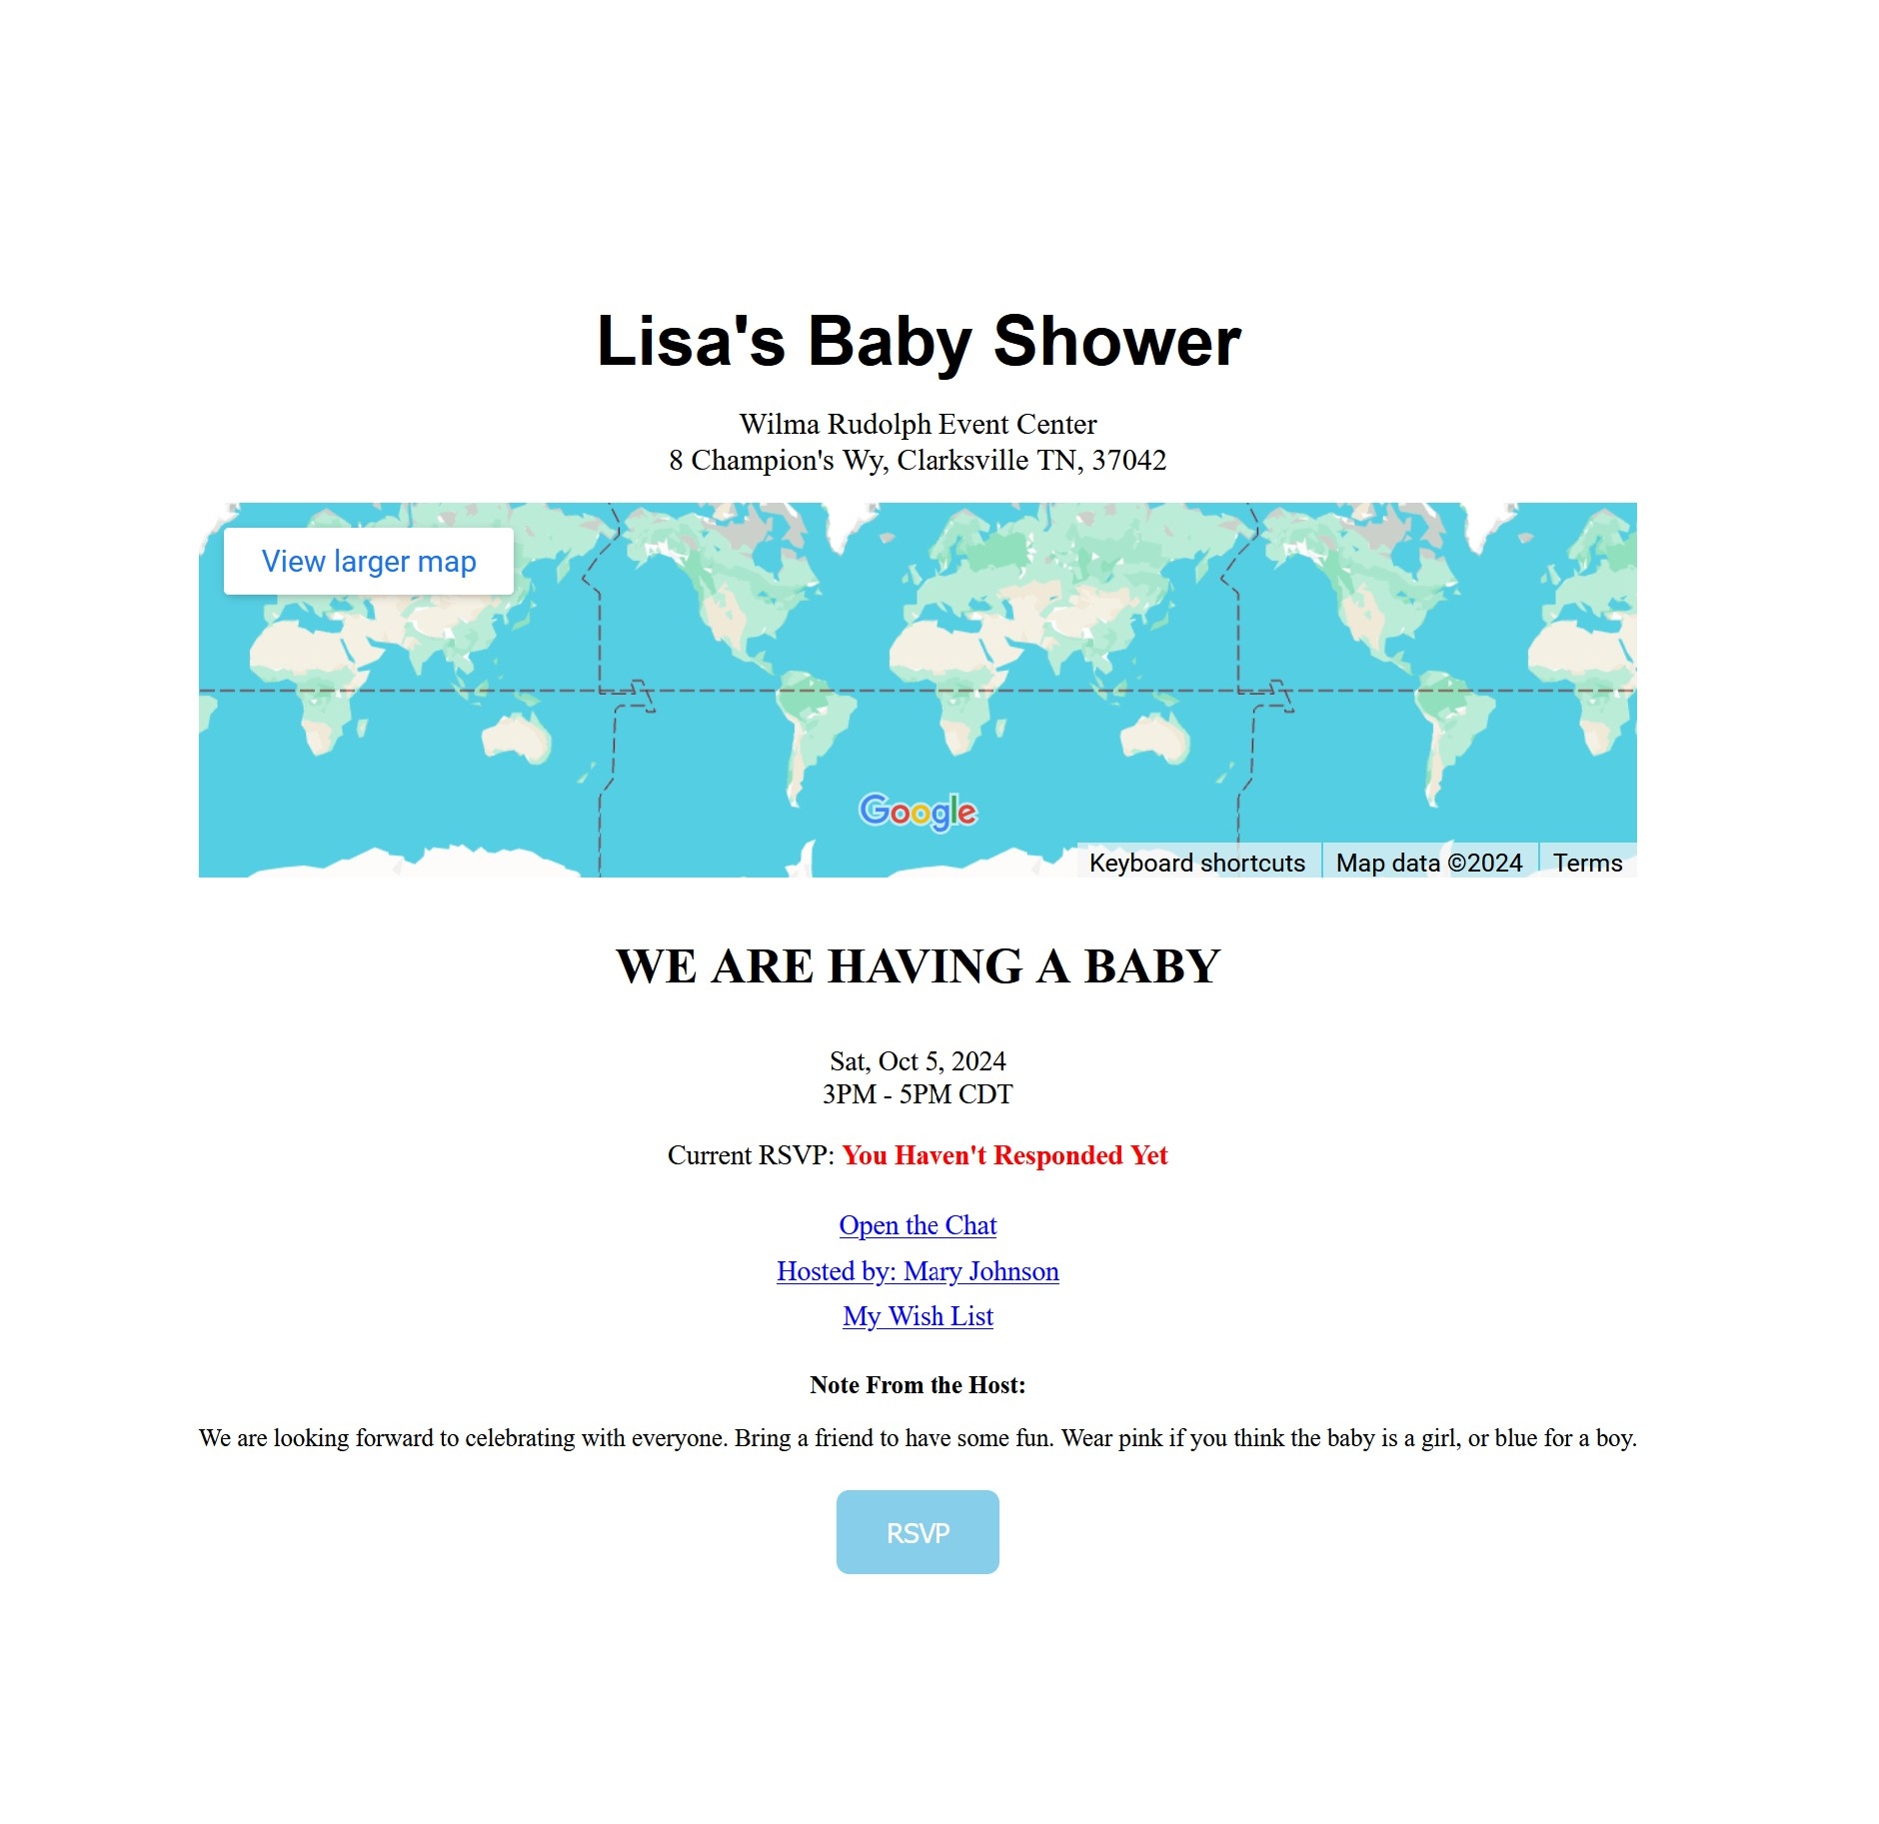
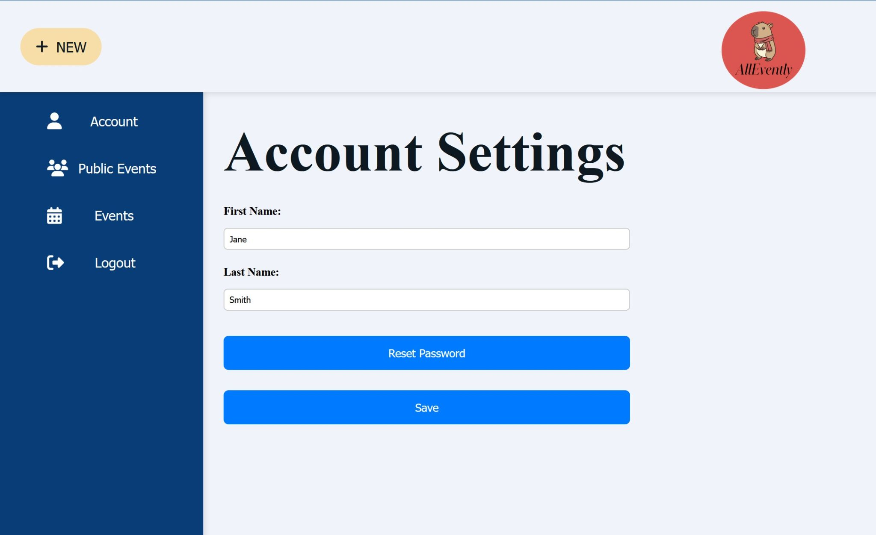
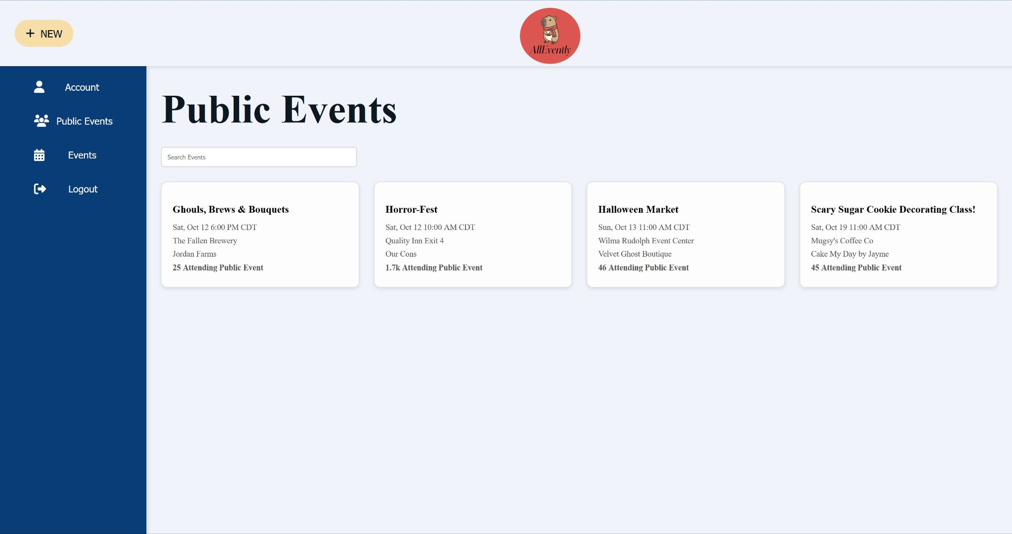
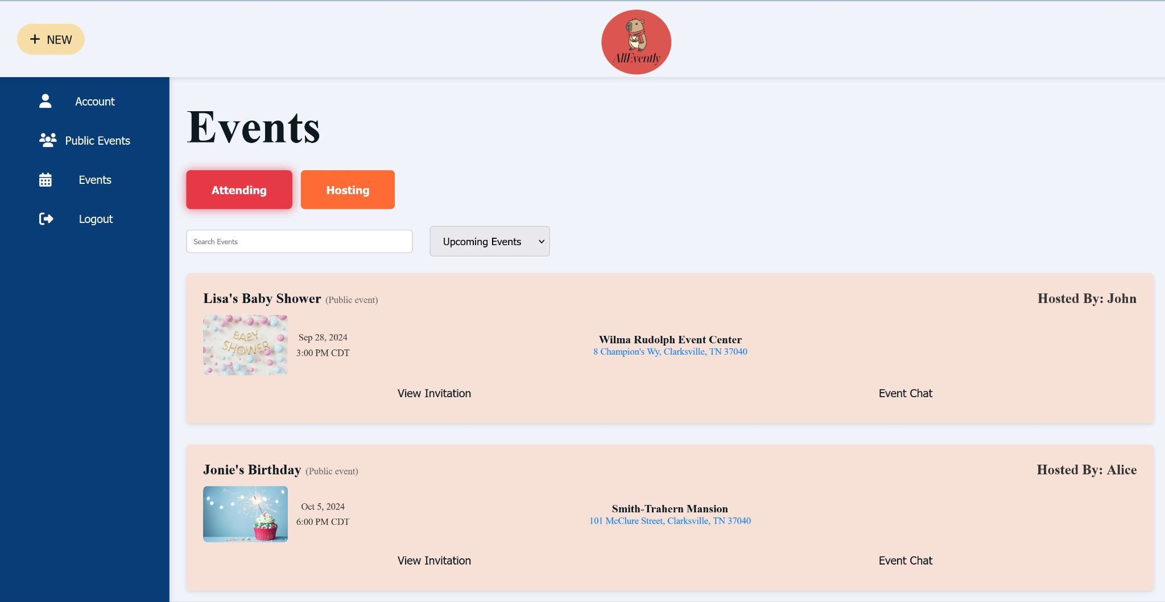
AllEvently
Benjamin Bruyns, Peggy Lewis, Spenser Morey
Dept. Of Computer Science and Information Technology
Abstract
Technology
Design
Future Work
AllEvently is a full-featured web application that streamlines event planning and management. It offers centralized event creation, management, tracking, customizable invitations, real-time RSVP tracking, and integrated event chat. With Google Maps verification and recurring event scheduling, AllEvently ensures seamless coordination. Its responsive design and intuitive interface provide easy navigation, strong database encryption, and secure user authentication, ensuring both reliability and security. Ideal for hosts and attendees, AllEvently simplifies event planning, enhancing productivity and user experience.
AllEvently will be written with HTML, CSS, and TypeScript. We will be using various frameworks such as Node.JS (a framework for running JavaScript), Express.Js (a framework for server-side web development), Vue.js (a front-end framework for developing the user interface), PostgreSQL (a framework for developing a relational database), and Vercel (the server that AllEvently will be hosted on).
We have chosen this tech stack for many reasons. All of the frameworks listed have immensely wide capabilities and many libraries within them which will allow us to tackle large tasks in a simpler method of development. These frameworks also have a large community of developers who provide resources and instructional articles about the intricacies of how they are used efficiently so they can be used to make a high-quality product.
Our website will have a fairly straightforward design that will provide users with the tools they need in an easily-understandable format. Customizing invitations will include pre-specified templates the user will choose from to avoid feeling overwhelmed from an overabundance of unnecessary tools. Specifying details of the event will be as simple as some checkboxes and fields to enter text. Sending invitations will just require the host to enter guest emails, and our website will handle the rest. The event chat function will be native to the website, and will provide the attendees and host a way to contact all members without them having to leave the website and manually send countless emails. Our overall design goal is to create a user-friendly experience that is simple to grasp and powerful in functionality.
There are some features we would like to implement into this project in addition to the primary ones we have targeted. We would like to allow hosts to insert their own custom images to invitations. Ideally hosts would be able to drag and drop their own elements onto the page and create more customizable invitations in whatever fashion they desire. We also would like to add a feature where the host and attendees can send images within the group chat; this would allow a photographer in attendance to send all images they captured to the guests for them to view and save to their devices.
Background
Planning an event, whether small or large, can become a very tiresome and convoluted task to tackle. Sending and managing invitations, contacting invitees, maintaining a list of all who will be in attendance, or specifying some of the crucial details of the event can all become quite overwhelming to handle on your own. With events that occur regularly such as weekly meetings can be especially tedious to plan and manage the schedule of them. AllEvently strives to provide a straightforward and user-friendly way to solve all of these issues in a streamlined and simple way to make any event easier to plan.
AllEvently is a web-based platform where users can create events where they specify the details such as suggested gifts, location, date, and time. It will provide a simplistic way for them to choose a style template and design their own custom invitation using our interface. The host can specify if the event is recurring or a one-time event, and in the case that it is recurring, AllEvently will send invitations to guests based on the schedule specified by the host. They can use our platform to send invitations to all guests digitally, and they can even choose to have a QR (Quick Response) code on their invitation which, upon scanning it, will take the guest to the RSVP page to notify the host about if they will be in attendance or not. Events will also have a group chat channel where guests can communicate amongst each other, and the host can send messages to guests in attendance to notify them of any changes or crucial information.
Figure 1: The Account Settings page for changing the user’s name and password.
Figure 2: The Public Event page contains events that anyone can attend.
Figure 4: The Invitation page displays the image that the user creates and send to their guests.
References
Node.JS: https://nodejs.org/en
Express.JS: https://expressjs.com/
Vue.js: https://vuejs.org/
PostgreSQL: https://www.postgresql.org/
Vercel: https://vercel.com/
Acknowledgements
We would like to thank Dr. Karen Meisch for her support of students in the College of Science, Technology, Engineering & Mathematics, and Dr. Leong Lee for his support of students in the Department of Computer Science and Information Technology.
Figure 3: The Events Page contains all events that you are invited to, attending, or hosting.

